Slide 1
Compiler Confidential
Eric Brumer

Slide 2
When you think “compiler”…

Slide 3
c:\work\a.cpp(82): error C2059: syntax error : ')'
c:\work\a.cpp(84): error C2015: too many characters in constant
c:\work\a.cpp(104): error C2015: too many characters in constant
c:\work\a.cpp(104): error C2001: newline in constant
c:\work\a.cpp(116): error C2015: too many characters in constant
c:\work\a.cpp(116): error C2001: newline in constant
c:\work\a.cpp(122): error C2153: hex constants must have at least one hex digit
c:\work\a.cpp(122): error C2001: newline in constant
c:\work\a.cpp(122): error C2015: too many characters in constant
c:\work\a.cpp(134): error C2015: too many characters in constant
c:\work\a.cpp(134): error C2001: newline in constant
c:\work\a.cpp(140): error C2015: too many characters in constant
c:\work\a.cpp(140): error C2001: newline in constant
c:\work\a.cpp(146): error C2001: newline in constant
c:\work\a.cpp(146): error C2015: too many characters in constant
c:\work\a.cpp(154): error C2146: syntax error : missing ';' before identifier 'modern'
c:\work\a.cpp(154): error C4430: missing type specifier - int assumed. Note: C++ does not support default-int
c:\work\a.cpp(154): error C2143: syntax error : missing ';' before '-'
c:\work\a.cpp(154): error C2015: too many characters in constant
c:\work\a.cpp(155): error C2059: syntax error : 'constant'
c:\work\a.cpp(155): error C2059: syntax error : 'bad suffix on number'
c:\work\a.cpp(158): error C2015: too many characters in constant
c:\work\a.cpp(158): error C2059: syntax error : ')'
c:\work\a.cpp(161): error C2001: newline in constant
c:\work\a.cpp(161): error C2015: too many characters in constant
c:\work\a.cpp(164): error C2059: syntax error : 'bad suffix on number'
c:\work\a.cpp(164): error C2059: syntax error : 'constant'
c:\work\a.cpp(168): error C2001: newline in constant
c:\work\a.cpp(168): error C2015: too many characters in constant
c:\work\a.cpp(178): error C2146: syntax error : missing ';' before identifier 'Examples'
c:\work\a.cpp(178): error C4430: missing type specifier - int assumed. Note: C++ does not support default-int
c:\work\a.cpp(178): error C2146: syntax error : missing ';' before identifier 'in'
c:\work\a.cpp(178): error C2146: syntax error : missing ';' before identifier 'C'
c:\work\a.cpp(178): error C2143: syntax error : missing ';' before '++'
c:\work\a.cpp(181): error C2146: syntax error : missing ';' before identifier 'Examples'
c:\work\a.cpp(181): error C4430: missing type specifier - int assumed. Note: C++ does not support default-int

Slide 4
void test(bool b) {
try {
if (b) {
MyType obj;
some_func(obj);
// ...
}
} catch (...) {
// ...
}
}
Destructor placement

Slide 5
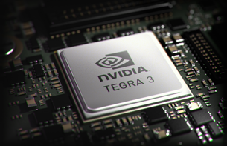
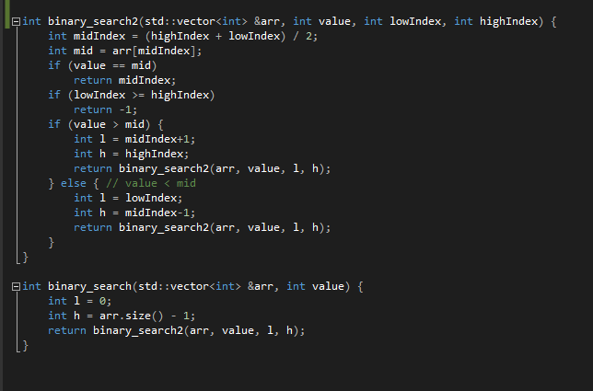
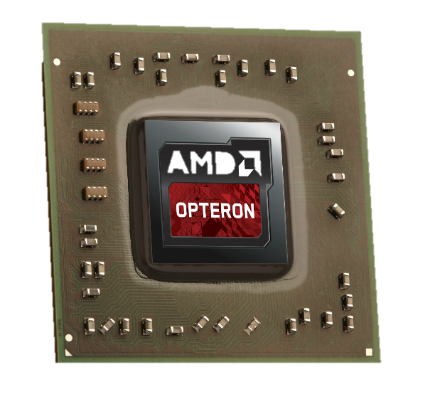
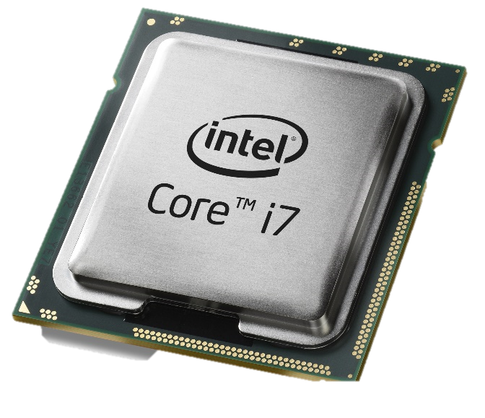
Code generation & optimization
Make my code run: code generation
Make my code run fast: optimization

Slide 6

Mission: expose some optimizer guts
There will be raw loops
There will be assembly code
There will be microarchitecture
I sense much
fear in you

Slide 7
Agenda
CPU hardware landscape
Vectorizing for modern CPUs
Indirect call optimizations

Slide 8
Agenda
CPU hardware landscape
Vectorizing for modern CPUs
Indirect call optimizations

Slide 9
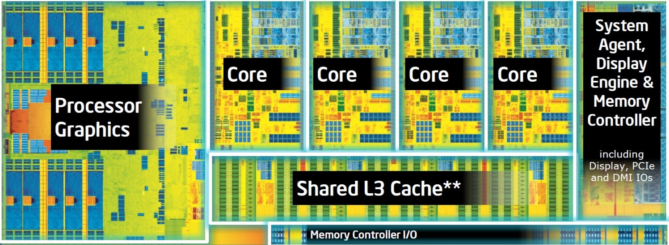

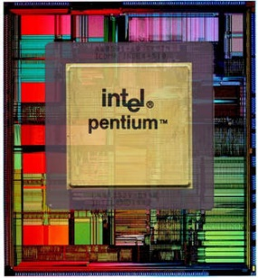
Hardware landscape
“Yesterday”
3.1 million transistors
Today
1.4 billion transistors
Not to scale

Slide 10
Automatic Vectorization
Take advantage of (fast) vector hardware
Execute multiple loop iterations in parallel
for (int i=0; i<1000; i++) {
A[i] = B[i] * C[i];
}
Speedup
32 bit operations
Vectorize
for (int i=0; i<1000; i+=4) {
A[i:i+3] = mulps B[i:i+3], C[i:i+3];
}
128 bit operations

Slide 11
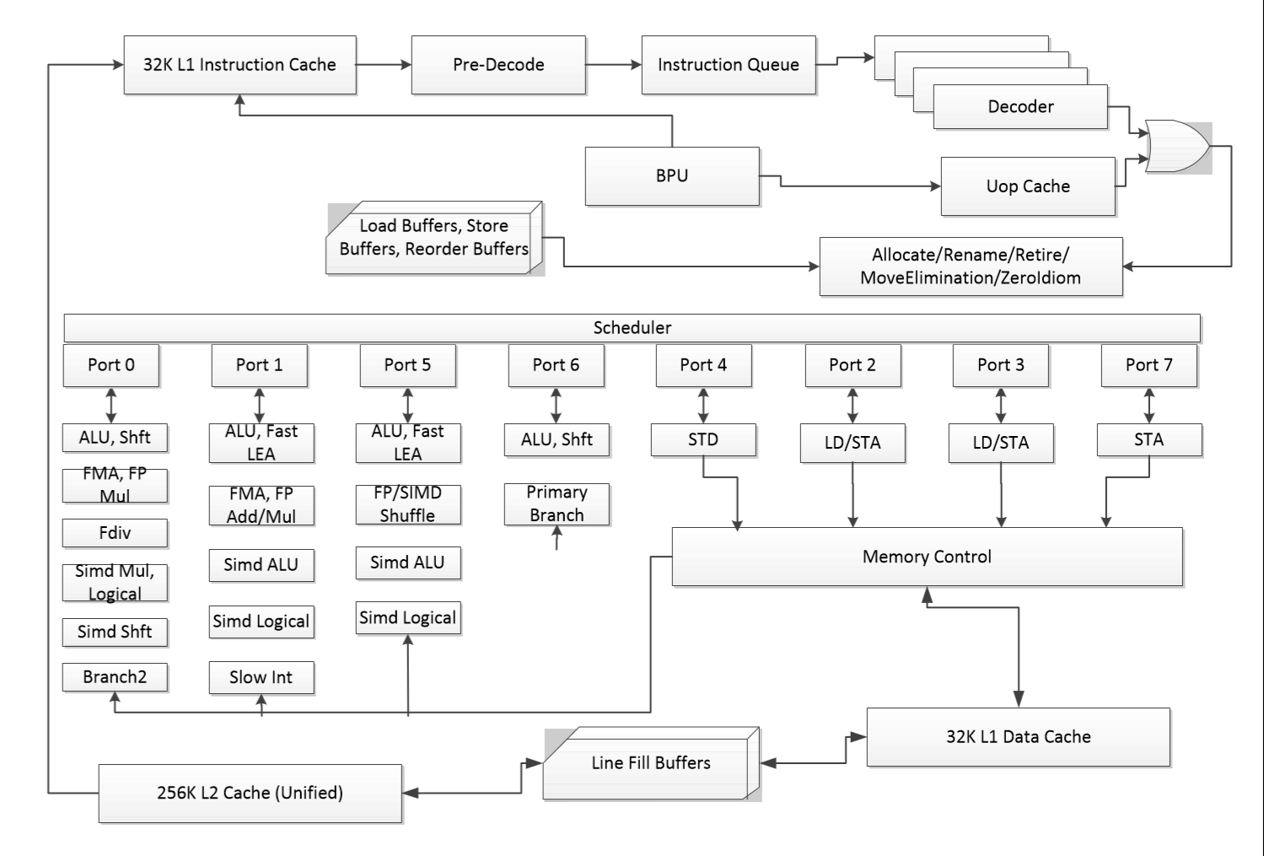
Front-end
Powerful branch predictor
Ship instructions to backend as fast as possible
Haswell core microarchitecture
Back-end
8 wide super scalar
Powerful vector units

Slide 12
Agenda
CPU hardware landscape
Vectorizing for modern CPUs
Indirect call optimizations

Slide 13
Approach to vectorizing for modern CPUs:
Take advantage of all the extra silicon
Key idea: conditional vectorization

Slide 14
Motivating example
void mul_flt(float *a, float *b, float *c) {
for (int i=0; i<1000; i++)
a[i] = b[i] * c[i];
}
a
b
c

Slide 15
Motivating example
void mul_flt(float *a, float *b, float *c) {
for (int i=0; i<1000; i++)
a[i] = b[i] * c[i];
}
a
b
c

Slide 16
Motivating example
void mul_flt(float *a, float *b, float *c) {
for (int i=0; i<1000; i++)
a[i] = b[i] * c[i];
}
a
b
c

Slide 17
Motivating example
void mul_flt(float *a, float *b, float *c) {
for (int i=0; i<1000; i++)
a[i] = b[i] * c[i];
}
a
b
c

Slide 18
Motivating example
void mul_flt(float *a, float *b, float *c) {
for (int i=0; i<1000; i++)
a[i] = b[i] * c[i];
}
Easy to vectorize
a
b
c

Slide 19
Motivating example
void mul_flt(float *a, float *b, float *c) {
for (int i=0; i<1000; i++)
a[i] = b[i] * c[i];
}
Easy to vectorize
a
4 at a time
b
c

Slide 20
Motivating example
void mul_flt(float *a, float *b, float *c) {
for (int i=0; i<1000; i++)
a[i] = b[i] * c[i];
}
What if there is overlap?
b
a
c

Slide 21
Motivating example
void mul_flt(float *a, float *b, float *c) {
for (int i=0; i<1000; i++)
a[i] = b[i] * c[i];
}
What if there is overlap?
b
a
c

Slide 22
Motivating example
void mul_flt(float *a, float *b, float *c) {
for (int i=0; i<1000; i++)
a[i] = b[i] * c[i];
}
What if there is overlap?
b
a
c

Slide 23
Motivating example
void mul_flt(float *a, float *b, float *c) {
for (int i=0; i<1000; i++)
a[i] = b[i] * c[i];
}
What if there is overlap?
b
a
c

Slide 24
Motivating example
void mul_flt(float *a, float *b, float *c) {
for (int i=0; i<1000; i++)
a[i] = b[i] * c[i];
}
What if there is overlap?
b
a
c

Slide 25
Motivating example
void mul_flt(float *a, float *b, float *c) {
for (int i=0; i<1000; i++)
a[i] = b[i] * c[i];
}
What if there is overlap?
b
a
c

Slide 26
Motivating example
void mul_flt(float *a, float *b, float *c) {
for (int i=0; i<1000; i++)
a[i] = b[i] * c[i];
}
What if there is overlap?
b
a
c

Slide 27
Motivating example
void mul_flt(float *a, float *b, float *c) {
for (int i=0; i<1000; i++)
a[i] = b[i] * c[i];
}
What if there is overlap?
b
a
c

Slide 28
Motivating example
void mul_flt(float *a, float *b, float *c) {
for (int i=0; i<1000; i++)
a[i] = b[i] * c[i];
}
What if there is overlap?
b
a
c

Slide 29
Motivating example
void mul_flt(float *a, float *b, float *c) {
for (int i=0; i<1000; i++)
a[i] = b[i] * c[i];
}
What if there is overlap?
b
a
c

Slide 30
Motivating example
void mul_flt(float *a, float *b, float *c) {
for (int i=0; i<1000; i++)
a[i] = b[i] * c[i];
}
What if there is overlap?
a[0] feeds c[2]
b
a
c

Slide 31
Motivating example
void mul_flt(float *a, float *b, float *c) {
for (int i=0; i<1000; i++)
a[i] = b[i] * c[i];
}
Vectorization is not legal!
b
a
c

Slide 32
Motivating example
void mul_flt(float *a, float *b, float *c) {
for (int i=0; i<1000; i++)
a[i] = b[i] * c[i];
}
Vectorization is not legal!
b
a
c

Slide 33
Motivating example
void mul_flt(float *a, float *b, float *c) {
for (int i=0; i<1000; i++)
a[i] = b[i] * c[i];
}
Vectorization is not legal!
b
a
c

Slide 34
Motivating example
void mul_flt(float *a, float *b, float *c) {
for (int i=0; i<1000; i++)
a[i] = b[i] * c[i];
}
Vectorization is not legal!
WRONG! We are reading c[2] without having first stored to a[0]
b
a
c

Slide 35
The presence of overlap prohibits vectorization
The presence of possible overlap prohibits vectorization
The compiler can still generate fast code

Slide 36
Conditional vectorization #1
void mul_flt(float *a, float *b, float *c) {
for (int i=0; i<1000; i++)
a[i] = b[i] * c[i];
}
Source code:
Runtime overlap checks
void mul_flt(float *a, float *b, float *c) {
if (a overlaps b) goto scalar_loop;
if (a overlaps c) goto scalar_loop;
for (int i = 0; i<1000; i+=4)
a[i:i+3] = mulps b[i:i+3], c[i:i+3];
return;
scalar_loop:
for (int i = 0; i<1000; i++)
a[i] = b[i] * c[i];
}
What we generate for you:
Vector loop
Scalar duplicate

Slide 37
Conditional vectorization #1
for (int i=0; i<1000; i++)
a[i] = b[i] * c[i];
4 instrs of runtime check, plus duplicate loop
mul_flt() code size increases by 7x
2.63x speedup
For reference, 2.64x speedup for vect w/o runtime check and the duplicate loop.
Why?

Slide 38
Conditional vectorization #2
for (k = 1; k <= M; k++) {
mc[k] = mpp[k-1] + tpmm[k-1];
if ((sc = ip[k-1] + tpim[k-1]) > mc[k]) mc[k] = sc;
if ((sc = dpp[k-1] + tpdm[k-1]) > mc[k]) mc[k] = sc;
if ((sc = xmb + bp[k]) > mc[k]) mc[k] = sc;
mc[k] += ms[k];
if (mc[k] < -INFTY) mc[k] = -INFTY;
dc[k] = dc[k-1] + tpdd[k-1];
if ((sc = mc[k-1] + tpmd[k-1]) > dc[k]) dc[k] = sc;
if (dc[k] < -INFTY) dc[k] = -INFTY;
if (k < M) {
ic[k] = mpp[k] + tpmi[k];
if ((sc = ip[k] + tpii[k]) > ic[k]) ic[k] = sc;
ic[k] += is[k];
if (ic[k] < -INFTY) ic[k] = -INFTY;
}
}
Loop

Slide 39
Conditional vectorization #2
for (k = 1; k <= M; k++) {
mc[k] = mpp[k-1] + tpmm[k-1];
if ((sc = ip[k-1] + tpim[k-1]) > mc[k]) mc[k] = sc;
if ((sc = dpp[k-1] + tpdm[k-1]) > mc[k]) mc[k] = sc;
if ((sc = xmb + bp[k]) > mc[k]) mc[k] = sc;
mc[k] += ms[k];
if (mc[k] < -INFTY) mc[k] = -INFTY;
dc[k] = dc[k-1] + tpdd[k-1];
if ((sc = mc[k-1] + tpmd[k-1]) > dc[k]) dc[k] = sc;
if (dc[k] < -INFTY) dc[k] = -INFTY;
if (k < M) {
ic[k] = mpp[k] + tpmi[k];
if ((sc = ip[k] + tpii[k]) > ic[k]) ic[k] = sc;
ic[k] += is[k];
if (ic[k] < -INFTY) ic[k] = -INFTY;
}
}

Slide 40
Conditional vectorization #2
for (k = 1; k <= M; k++) {
mc[k] = mpp[k-1] + tpmm[k-1];
if ((sc = ip[k-1] + tpim[k-1]) > mc[k]) mc[k] = sc;
if ((sc = dpp[k-1] + tpdm[k-1]) > mc[k]) mc[k] = sc;
if ((sc = xmb + bp[k]) > mc[k]) mc[k] = sc;
mc[k] += ms[k];
if (mc[k] < -INFTY) mc[k] = -INFTY;
dc[k] = dc[k-1] + tpdd[k-1];
if ((sc = mc[k-1] + tpmd[k-1]) > dc[k]) dc[k] = sc;
if (dc[k] < -INFTY) dc[k] = -INFTY;
if (k < M) {
ic[k] = mpp[k] + tpmi[k];
if ((sc = ip[k] + tpii[k]) > ic[k]) ic[k] = sc;
ic[k] += is[k];
if (ic[k] < -INFTY) ic[k] = -INFTY;
}
}
42 runtime checks needed
84 cmp/br instructions, duplicate loop
Loop code size increases by 4x
Doesn’t this suck?
2x loop speedup
30% overall benchmark speedup
For reference, 2.1x speedup for vect w/o runtime check

Slide 41
Agenda
CPU hardware landscape
Vectorizing for modern CPUs
Indirect call optimizations

Slide 42
typedef int (PFUNC)(int);
int func1(int x) {
return x + 100;
}
int func2(int x) {
return x + 200;
}
int test(PFUNC f) {
return f(3);
}
mov ecx, f$
push 3
call [ecx]
This sucks

Slide 43
mov ecx, f$
push 3
call [ecx]

Slide 44
mov ecx, f$
push 3
call [ecx]
Stall

Slide 45
typedef int (PFUNC)(int);
int func1(int x) {
return x + 100;
}
int func2(int x) {
return x + 200;
}
int test(PFUNC f) {
return f(3);
}
int test(PFUNC f) {
if (f == func1) return func1(3);
if (f == func2) return func2(3);
return f(3);
}
mov ecx, f$
push 3
cmp ecx, &func1
jne $LN1
call func1
ret
$LN1:
cmp ecx, &func2
jne $LN2
call func2
ret
$LN2:
call [ecx]
Leverage
branch predictor

Slide 46
mov ecx, f$
push 3
cmp ecx, &func1
jne $LN1
call func1
mov ecx, f$
push 3
cmp ecx, &func1
jne $LN1
call func1
ret
$LN1:
cmp ecx, &func2
jne $LN2
call func2
ret
$LN2:
call [ecx]

Slide 47
mov ecx, f$
push 3
cmp ecx, &func1
jne $LN1
call func1
ret
$LN1:
cmp ecx, &func2
jne $LN2
call func2
ret
$LN2:
call [ecx]
mov ecx, f$
push 3
Predict
cmp ecx, &func1
jne $LN1
Speculatively
execute
Depen-
dence
call func1

Slide 48
int test(PFUNC f) {
return f(3);
}
int test(PFUNC f) {
if (f == func1) return func1(3);
if (f == func2) return func2(3);
return f(3);
}
mov ecx, f$
push 3
call [ecx]
mov ecx, f$
push 3
cmp ecx, &func1
jne $LN1
call func1
ret
$LN1:
cmp ecx, &func2
jne $LN2
call func2
ret
$LN2:
call [ecx]
Stall
Not a stall
Speedup due to if-statements + branch prediction
You could add if-statements by hand…
But with profile counts, the compiler does it for you.

Slide 49
If counts say test() calls func1() as often as func2():
Compiler inserts two if-checks
test() code size increases 5.4x
10% performance win
If counts say test() calls func1() way more than func2():
Compiler inserts one if-check
test() code size increases 3.4x
15% performance win
If counts say test() calls func1() way more than func2(), and we decide to inline func1():
Compiler inserts one if-check
test() code size increases 2.7x
30% performance win
if (f == func1)
return func1(3);
if (f == func2)
return func2(3);
return f(3);
Source code:
typedef int (PFUNC)(int);
int func1(int x) {
return x + 100;
}
int func2(int x) {
return x + 200;
}
int test(PFUNC f) {
return f(3);
}
if (f == func1)
return func1(3);
return f(3);
if (f == func1)
return 103;
return f(3);
All compiler driven – no code changes!

Slide 50
That’s nice, but I don’t use function pointers

Slide 51
class Base {
public:
virtual int func(int x) = 0;
};
class A : public Base {
int func(int x) { return x + 100; };
};
class B : public Base {
int func(int x) { return x + 200; };
};
class C : public Base {
int func(int x) { return x + 300; };
};
int test(Base *x) {
return x->foo(3);
}
Load vtable
Load right ‘func’
mov ecx, x$
mov eax, [ecx]
push 3
call [eax]
Push argument
Indirect call
Compiler-driven speculative devirtualization & inlining

Slide 52
Recap & other resources
Compiler has to take advantage of silicon
Guard optimizations with runtime checking
/Qvec-report:2 messages (15xx codes ~ runtime checks)
Profile counts: profile guided optimizations
Profiling tools
Visual Studio Performance Analysis
Intel VTune Amplifier XE
AMD CodeXL

Slide 53
Compiler switches
http://msdn.microsoft.com
Automatic vectorization blog & cookbook http://blogs.msdn.com/b/nativeconcurrency
Visual C++ blog
http://blogs.msdn.com/b/vcblog/
Channel 9 Going Native http://channel9.msdn.com/Shows/C9-GoingNative

Slide 54
Q&A

Slide 55
Backup slides

Slide 56
Wild and crazy runtime checks
for (int i=0; i<1000; i++)
a[i] = b[i] * 2.0f;
Range of a: &a[0] to &a[999]
Range of b: &b[0] to &b[999]

Slide 57
Wild and crazy runtime checks
for (int i=0; i<1000; i++)
a[i] = b[i+1] * 2.0f;
Range of a: &a[0] to &a[999]
Range of b: &b[1] to &b[1000]

Slide 58
Wild and crazy runtime checks
Messup in the presentation slides. B ends at b[1004].
Another reason why the compiler should do this for you!
for (int i=0; i<1000; i++)
a[i] = b[i+1] + b[i+5];
Range of a: &a[0] to &a[999]
Range of b: &b[1] to &b[1004]

Slide 59
Wild and crazy runtime checks
for (int i=0; i<1000; i++)
a[i] = b[i+1] + b[i+x];
Range of a: &a[0] to &a[999]
Range of b: &b[?] to &b[?]

Slide 60
Wild and crazy runtime checks
for (int i=lb; i<ub; i++)
a[i] = b[i*i];
Range of a: &a[lb] to &a[ub]
Range of b: &b[?] to &b[?]

